Slide 1


Arowwai Industries
Home
Service
About Me
Contact
HOUSE
PRICE PREDICTION

Slide 2

Arowwai Industries
Home
Service
About Me
Contact
Problem statement
The real estate market is constantly evolving, with property prices influenced by factors such as location, property size, number of rooms, available amenities, and changing market trends.
Frequent price fluctuations and reliance on subjective, traditional valuation methods make accurate house price estimation difficult.
As a result, buyers, sellers, and real estate companies face challenges in setting fair prices and making informed decisions.

Slide 3
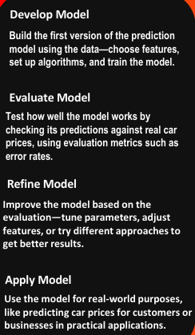
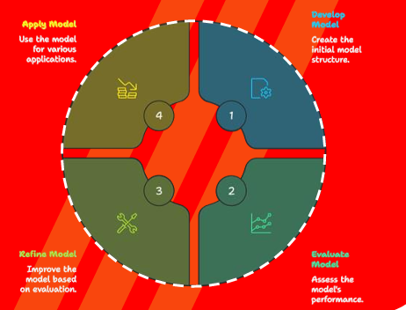
Arowwai Industries
Home
Service
About Me
Contact
House Price Prediction
Cycle
REAL ESTATE PRESENTATION

Slide 4
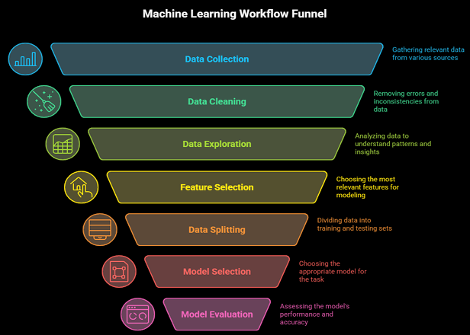

Arowwai Industries
Home
Service
About Me
Contact

Slide 5

Arowwai Industries
Home
Service
About Me
Contact
OVERVIEW
147536
Records
13
Features
Dataset Overview
The project utilizes a large-scale industrial real estate dataset collected from online property listings and industry sources. The dataset contains over 147,000 property records and includes a rich set of features such as location details, building characteristics, apartment specifications, and pricing information. These attributes are highly relevant for analyzing real estate market behavior and are well-suited for regression-based house price prediction. The diversity and volume of the data enable effective modeling of complex relationships between property features and market prices.
REAL ESTATE PRESENTATION

Slide 6
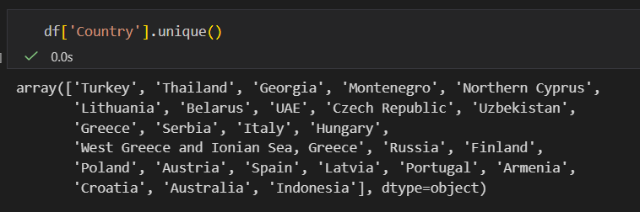
Arowwai Industries
Home
Service
About Me
Contact
The dataset deals with 20 different countries
REAL ESTATE PRESENTATION

Slide 7

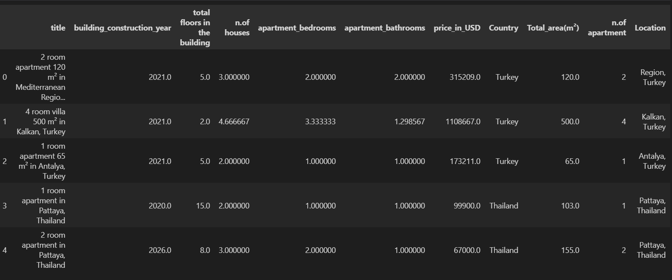


Arowwai Industries
Home
Service
About Me
Contact
Vision 01
REAL ESTATE PRESENTATION

Slide 8
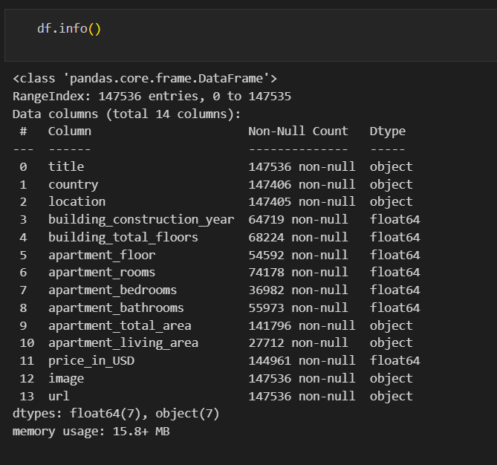
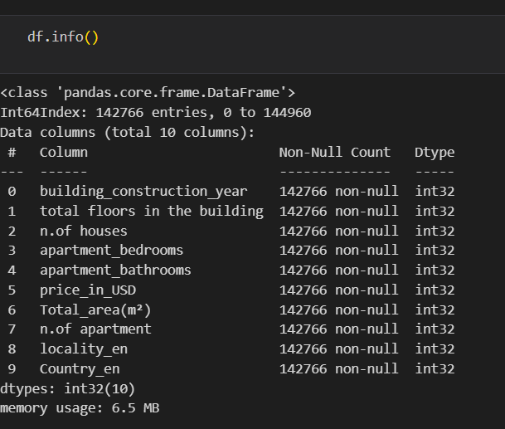
Arowwai Industries
Home
Service
About Me
Contact
Vision 01
Vision 02
RAW DATA
Cleaned Data

Slide 9




Arowwai Industries
Home
Service
About Me
Contact
Data preprocessing challenges
1. Missing Values
Attributes like constructed year, bathrooms, area, amenities often contain nulls.
Missingness is not random (e.g., older houses missing year data).
Choosing between mean/median, KNN, or iterative imputation impacts model bias and accuracy.
2. Outliers and Extreme Prices
Property prices and area (sqft) show heavy right skewness.
Luxury properties act as outliers, inflating MSE/RMSE.
Removing them risks losing valuable business insights, while keeping them hurts model stability.

Slide 10
Arowwai Industries
Home
Service
About Me
Contact
Data preprocessing challenges
3. Skewed Feature Distributions
Features like price, area, number of rooms are non-normally distributed.
Skewness violates assumptions of linear models and degrades performance.
Requires log / Box-Cox transformations, adding preprocessing complexity
4. Feature Scaling Issues
Features vary widely in scale (floors vs area vs price).
Distance-based and gradient-based models are sensitive to scaling.
Scaling must be applied after train–test split to avoid leakage.

Slide 11
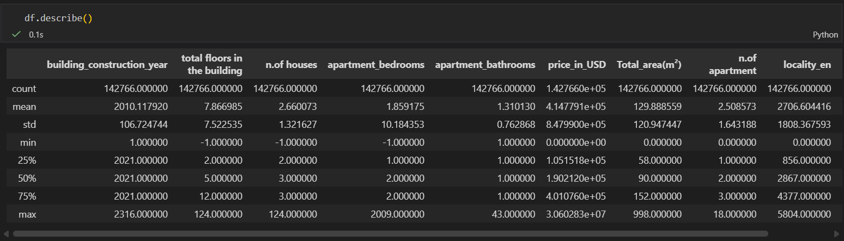
Arowwai Industries
Home
Service
About Me
Contact
Summary of cleaned Data

Slide 12
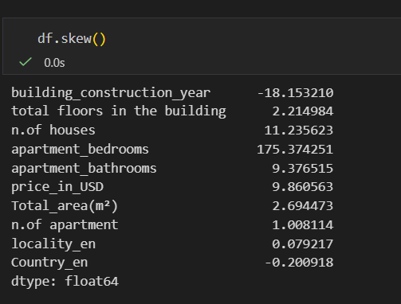
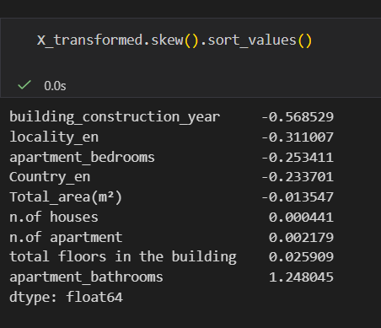
Arowwai Industries
Home
Service
About Me
Contact
Non-linear due to skewness
Highly deals with skewness
After reducing the skewness

Slide 13
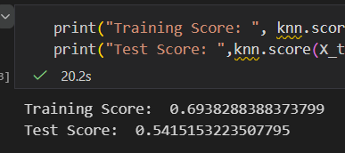
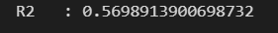
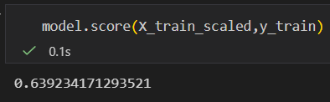
Arowwai Industries
Home
Service
About Me
Contact
KNN Regressor
RandomForestRegressor
REAL ESTATE PRESENTATION

Slide 14
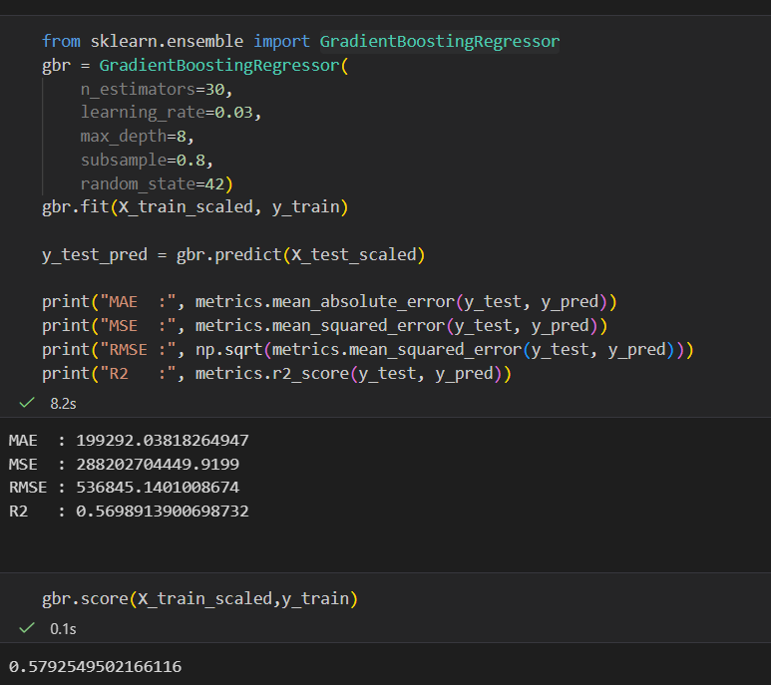
Arowwai Industries
Home
Service
About Me
Contact
GradientBoostingRegressor
REAL ESTATE PRESENTATION

Slide 15
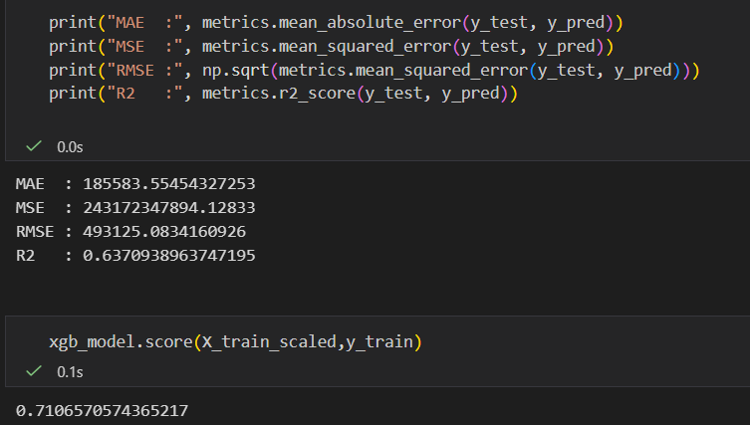
Arowwai Industries
Home
Service
About Me
Contact
XGBRegressor
REAL ESTATE PRESENTATION

Slide 16

Arowwai Industries
Home
Service
About Me
Contact
THANK YOU
REAL ESTATE PRESENTATION

